Slide 1

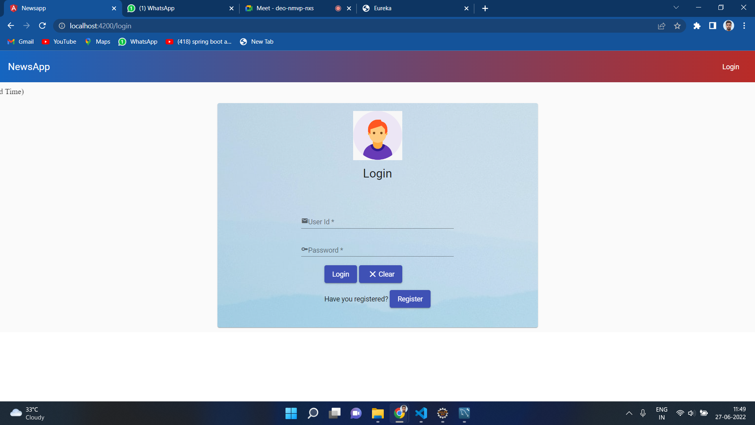
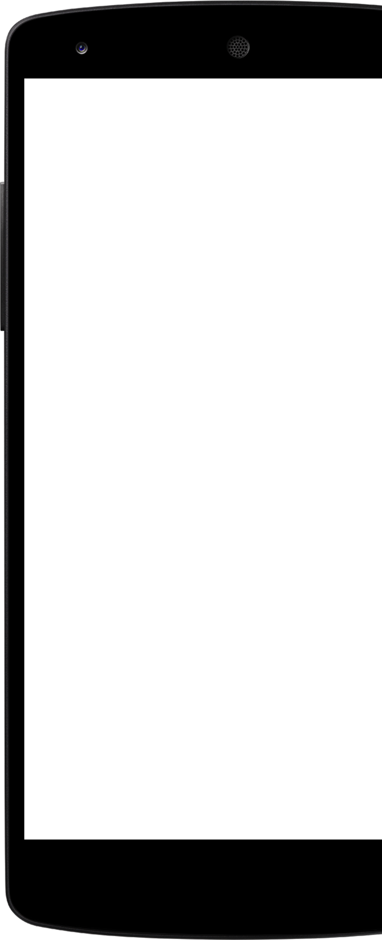
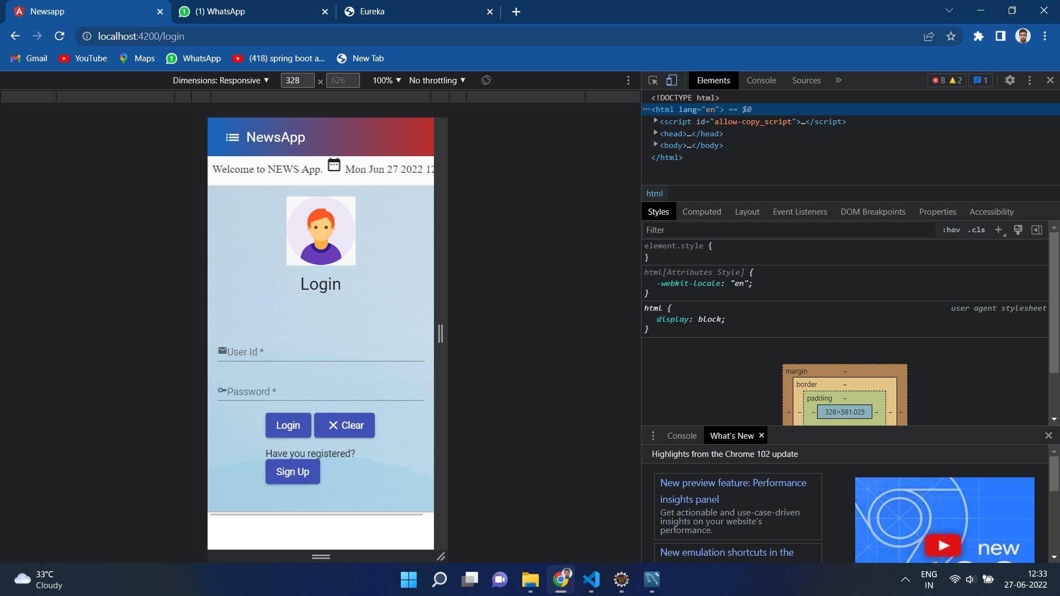
News App Case Study

Slide 2
Group
Members
Prakhar Katare
Srinjit Bhattacharyya
Rita Vijay Gujar
Arjun Porey
Dhruvin Rajanbhai Mehta

Slide 3
Outline
Problem Statement
Objective
Project Overview
Project Flow
Project Architecture
Tools Used
Conclusion

Slide 4
Problem statement
Ramesh is a busy person.
Amidst his duties, he doesn’t even get the time to read a newspaper.
Ramesh wants his news to be virtual so that he can access it with just a flick of his finger or the click of a mouse!

Slide 5
Objective
We aim to provide Ramesh with a virtual alternative to newspapers, that is extensive, reliable, detailed and user-friendly.

Slide 6
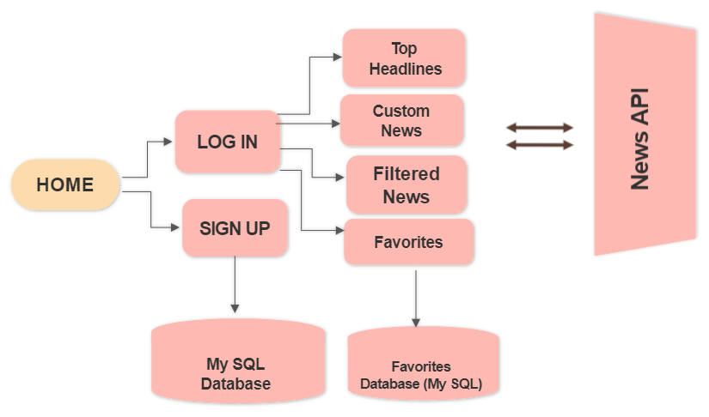
Project Overview

Slide 7
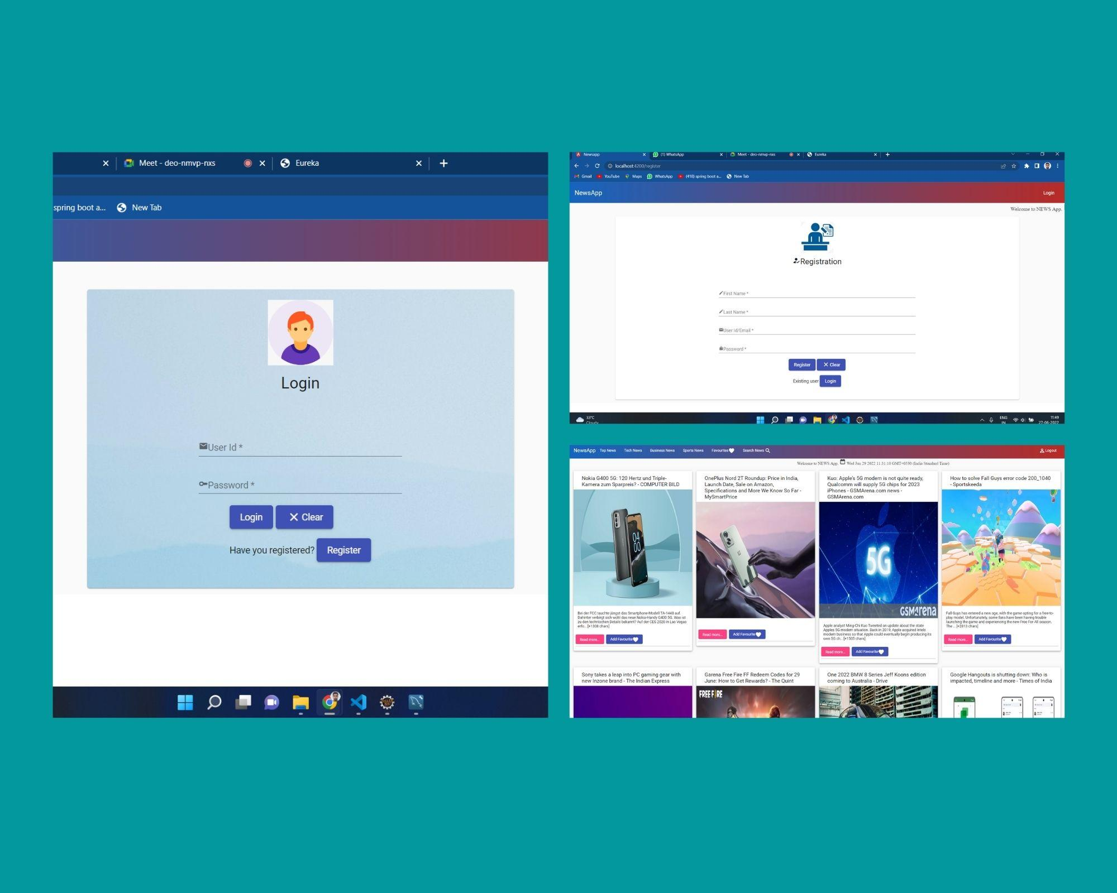
SNAPSHOTS

Slide 8
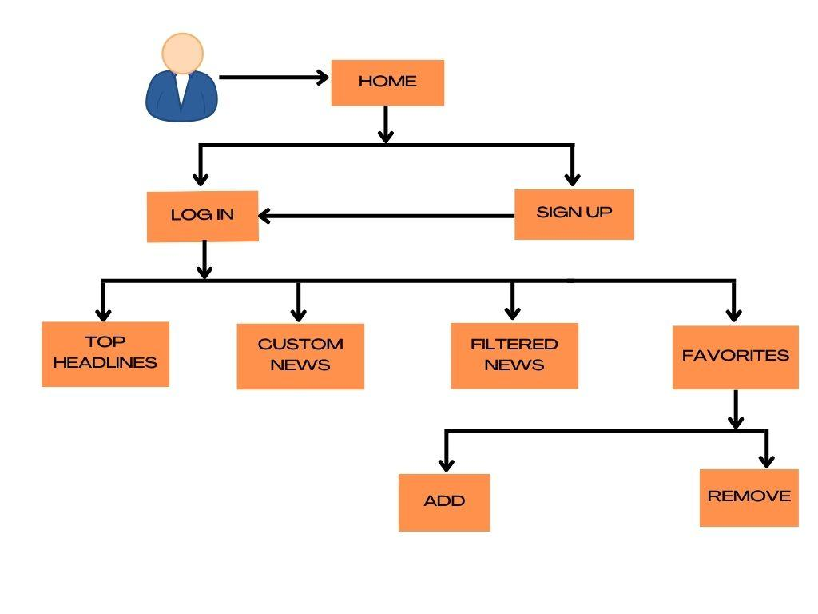
Project Flow

Slide 9
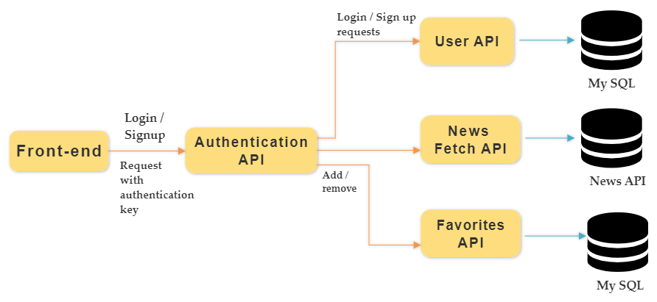
Project Architecture

Slide 10






Tools Used

Slide 11
CONCLUSION
The News app provides the user with a virtual platform, containing details about live events happening in every corner of the world.
It is a thorough, trustworthy and easy-to-use alternative to our boring regular newspapers.

Slide 12
Thank You!

